Slide 1
Opinion-aware Answer Generation for Review-driven Question Answering in E-Commerce
Advisor: Jia-Ling Koh
Presenter: Cheng-Wei Chen
Source: CIKM’20
Data: 2021/2/8

Slide 2
Outline
Introduction
Method
Experiment
Conclusion

Slide 3
Outline
Introduction
Target
Previous work
Change in this work

Slide 4
Introduction-target
Question
Community
Question Answering
System
Answer
User
E-commerce

Slide 5
Previous work

Slide 6
Change in this paper
Approach | Method
Opinion-based | Yes/No
Retrieval-based | Most related review
Generation-based | Natural forms of answer hold a random opinion
Opinion-aware Generation | Considering Differ in customer’s opinions Interactions between questions and review

Slide 7
Outline
Method
Architecture
Question-Review Reader
Opinion Classifier
Answer Generator
Loss

Slide 8
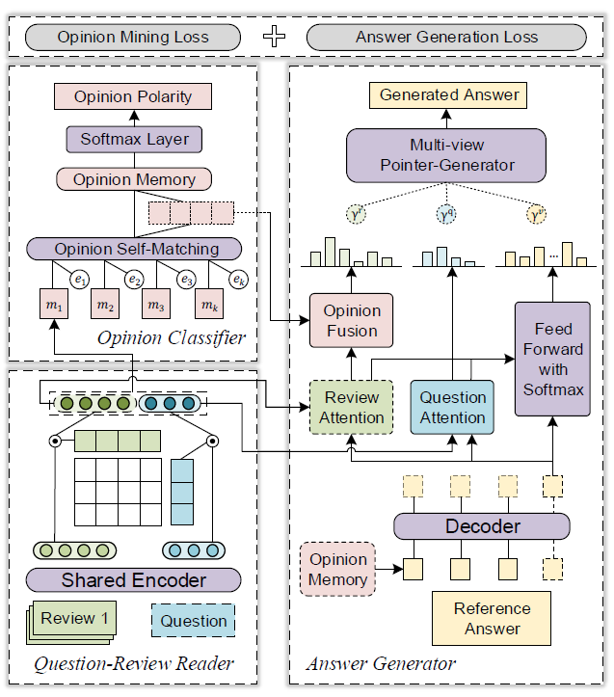
Architecture
INPUT:
Question: q^{i}
Reviews: {r^{i}₁,r^{i}₂…..r^{i}_{k}}
Ratings: {e^{i}₁,e^{i}₂…..e^{i}_{k}}
Reference Answer: a^{i}
Opinion type: l^{i}

Slide 9
Question-Review Reader
rk1 rk2 rk3 rk4 rk5…..
𝐻_{𝑞} = Bi-LSTM (𝑊_{𝑞})
𝐻_{𝑟𝑘} = Bi-LSTM (𝑊_{𝑟𝑘} )
q1
q2
q3
q4
q5
…..
(L_{q} * dh)
(dh * L_{rk})
Ω𝑞𝑟𝑘 = tanh(𝐻_{𝑞} 𝑈 𝐻⊺_{𝑟𝑘})
(dh * dh)

Slide 10
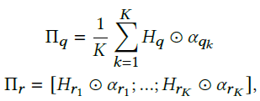
Question-Review Reader
(L_{q} * dh)
(L_{q} * 1)
Π𝑞 ={𝜋^{𝑞}₁ , ..., 𝜋^{𝑞}_{1q}}
Πr ={𝜋^{r}₁ , ..., 𝜋^{r}_{1r}}
[Encoded Representations]
𝑚𝑘 = [𝐻⊺𝑞 𝛼𝑞𝑘 : 𝐻⊺ 𝑟𝑘 𝛼𝑟𝑘 ]
[As input of the opinion classifier]

Slide 11
Question-Review Reader
𝑚𝑘
Π𝑞
Πr
𝛼𝑟𝑘
Ω𝑞𝑟𝑘
𝛼𝑞𝑘
Bi-LSTM

Slide 12
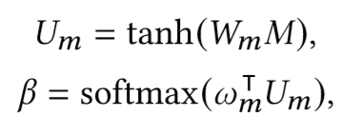
Opinion Classifier
Rating
(dm *k)
(k*1)
X
T
Context Vector
(dm *k)
(dm*dm)
(dm*k)
(3*dm)
(3*1)
(dm*1)
(1*dm)
(dm*k)
Predicted probability of
the answer opinion polarities
Review-level opinion attention

Slide 13
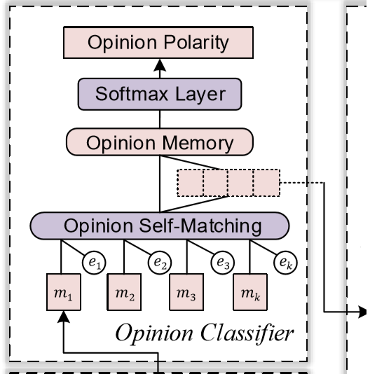
Opinion Classifier
𝑝^{𝑜}
𝛽
Context Vector

Slide 14
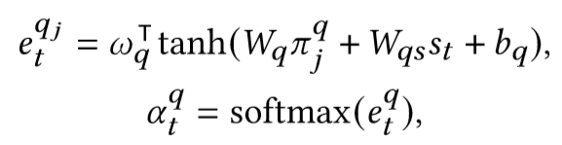
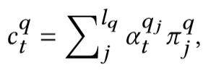
Answer Generator
Reference Answer
Related between Review & Question word j
(From Question-Review Reader)
𝑠_{𝑡} = LSTM(𝑠_{𝑡−1},𝑤_{𝑡−1})
𝑠₀ =
Answer representation
The same to

Slide 15
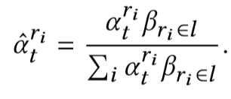
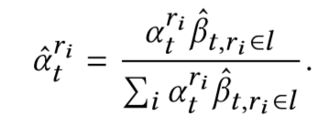
Answer Generator
Opinion Fusion
Consider attention in Review/Opinion
𝑜_{𝑘} = 𝛽_{𝑘}𝑚ˆ_{𝑘}
Static Fusion
Dynamic Fusion
Answer will be limited since unchanged 𝛽_{𝑘}

Slide 16
Answer Generator
h^{s}_{𝑡}
𝛼^{𝑞}_{𝑡}
𝛼^{ri}_{𝑡}
LSTM
X
Multi-view pointer scalar

Slide 17
Loss
Reference Label
Opinion Mining Loss
Answer Generation Loss
Reference Answer

